Slide 1


Club Navigator
Problem Category
“Any other problem faced by students or faculty members by providing a new solution to a problem concerning different stakeholders of the university at large”
By
The code conquerors
Apurva Gokhale
Arjun deodhar
Avnish Chaudhary
Deep oak
Dhruv sadhale
Tanmay chhatre
“Initiate, Innovate and Implement for Smarter University"
COEP Technological University
A Unitary Public University of Govt. of Maharashtra
Formerly College of Engineering Pune

Slide 2
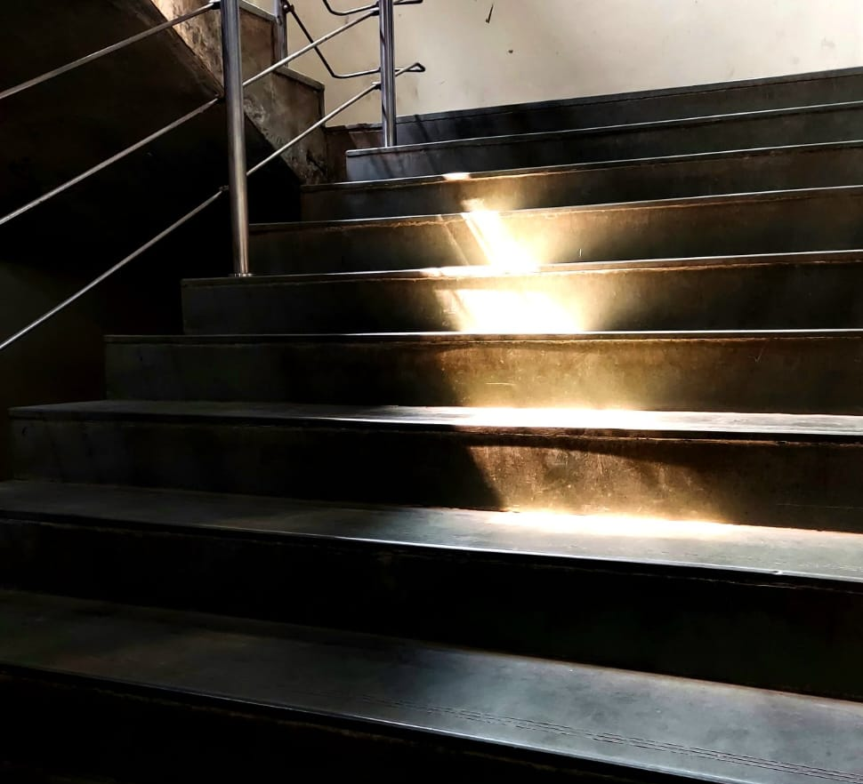
WHY IS A CLUB SELECTION SYSTEM NEEDED?
SCHEDULING CONFLICTS
ACADEMIC STRAIN
INCOMPLETE CLUB
Overwhelming of FYs by Club Options
Lack of transparency and guidance
COMMITMENTS
STRUGGLE FOR
INFORMED DECISIONS
COEP Technological University
A Unitary Public University of Govt. of Maharashtra
Formerly College of Engineering Pune

Slide 3
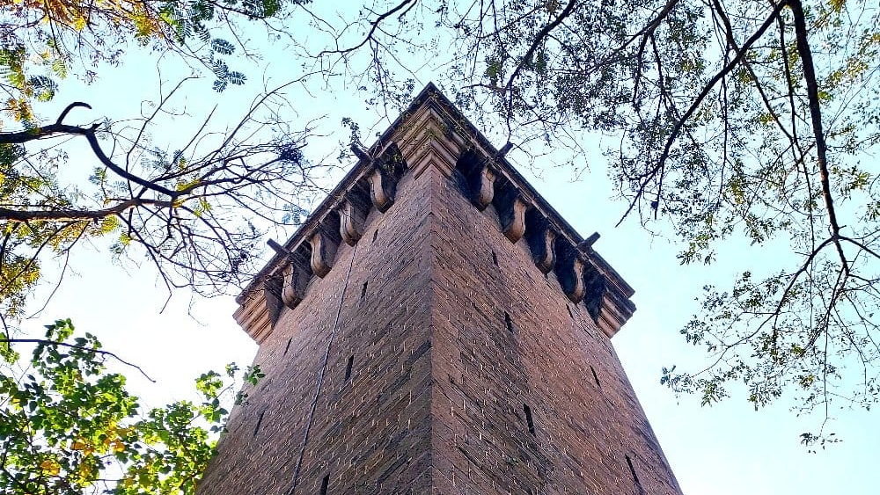
KEY FEATURES
Web pages for each club with event highlights, heads, and induction processes
Simplified digital method for taking permissions from higher authorities for club activities
User accounts with decision tree supported selection tests for personalized club recommendations
Feedback portal for test improvement
Notification system for induction details
Individual user stats
COEP Technological University
A Unitary Public University of Govt. of Maharashtra
Formerly College of Engineering Pune

Slide 4
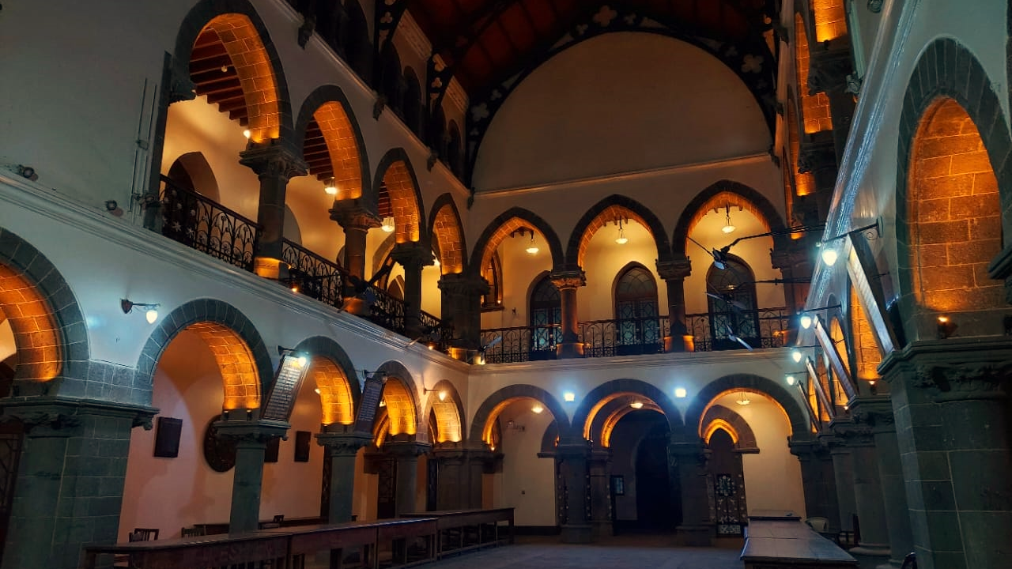
CLUB SELECTION TEST
PSYCHOMETRIC APPROACH
ADAPTIVE QUESTIONING
PERSONALISED TOP 3 CLUBS
OPEN TO FEEDBACK
COEP Technological University
A Unitary Public University of Govt. of Maharashtra
Formerly College of Engineering Pune

Slide 5






Tech stack
COEP Technological University
A Unitary Public University of Govt. of Maharashtra
Formerly College of Engineering Pune

Slide 6
AIMS
UNIQUE
ROBUSTNESS
EFFICIENCY
TRANSPARENCY
First-of-its-kind web application targeting the critical aspect of student club selection and engagement
Consolidates club information into one user-friendly platform, saving time and aiding decision-making
Constant feedback loop enhances system effectiveness and transparency
Increases visibility into club activities and fest highlights, promoting informed decisions and participation
COEP Technological University
A Unitary Public University of Govt. of Maharashtra
Formerly College of Engineering Pune

